Slide 1
DC CIRCUIT AND RESISTANCE
HANSABA COLLEGE OF ENGINEERING AND TECHNOLOGY, SIDHPUR (098)
INSTITUTE GUIDE
SHRUJAL R PATEL
ELE DEPT. HCET SIDHPUR
Branch :- Mechanical (B23)
Prajapati Mehul C (130980119085)
Maheshwari Jigar J(130980119041)
Maheshwari Kailash M.(13098011042)
Jafari Kamaranhusain M.(130980119032)

Slide 2
Electric Current and Resistance

Slide 3
Part I
Basic electric circuit and its diagram.
What causes the flow of electrons in a circuit.
Drift velocity.
Voltaic cell.

Slide 4
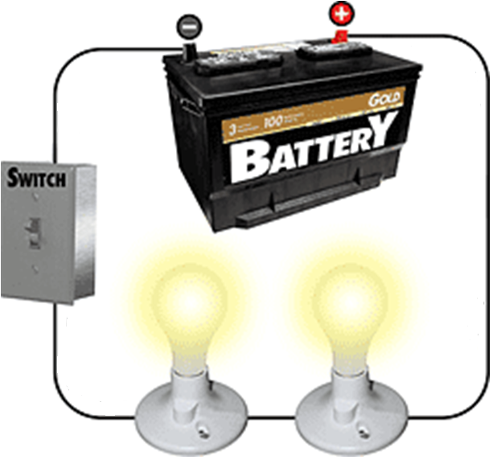
Electric Circuit

Slide 5
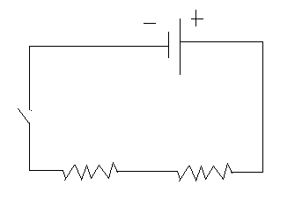
Diagram of Electric Circuit

Slide 6
Remember: Electric Potential Energy- Two Unlike Charges
+
Higher Potential Energy
-
Lower Potential Energy
To cause movement of a charge, there must be a potential difference

Slide 7
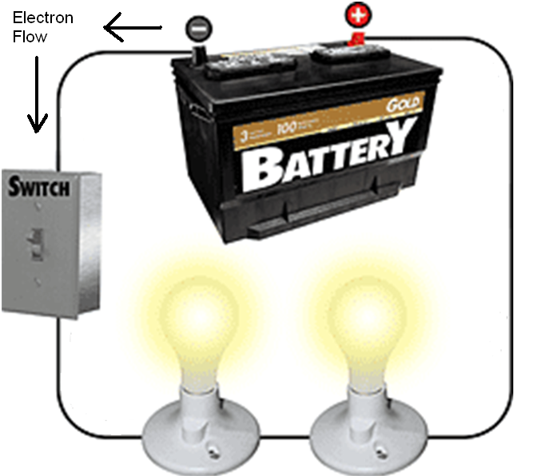
Closing the switch establishes a potential difference (voltage) and an electric field in the circuit.
Electrons flow in a net direction away from the (-) terminal.

Slide 8
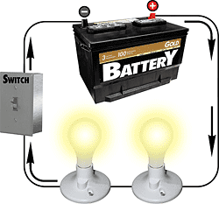
Conventional Current
By tradition, direction in which “positive charges” would flow.
Direction is opposite of electron flow.

Slide 9
Battery (Chemical Cell):
A device that converts chemical energy to electricity.
A battery provides a potential energy difference (voltage source).

Slide 10
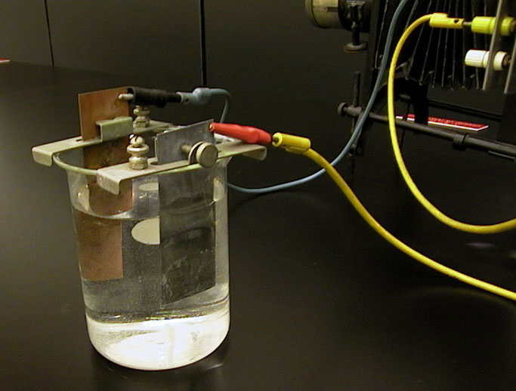
Voltaic Cell
Alessandro Volta (1800’s)
Battery

